Slide 1
Spatio-temporal pattern of Mortality in Thailand

Slide 2
Socioeconomic inequality in Thailand
Source: National Economic and Development Board. Social and Quality of Life Database System, 2012
Notes:
Next, let me move to inequality trend in Thailand. and right graph show the relative poverty
Graph on the left hand side is the absolute poverty which showing that during the past two decades, Thailand has experienced very impressive economic growth (with some interruption due to the 1997 economic crisis). Absolute poverty have declined markedly from 65 percent in 1988 to 12 percent in 2012 ; however, if we look at the graph of relative poverty on the right side. The country still faces challenges with poverty and inequality. Poverty in rural areas is still the main problem of Thailand. The incidence of the poor in urban area is about 8% of the total population, while in the rural area is around 16% of the population. This reflex the differences of poverty between rural and urban areas. Although, both absolute and relative poverty incidences show decreasing trend, the Gini coefficient has persisted at high level of average 0.5 which is among the highest in the world. There is therefore a need to explore in much detail.

Slide 3
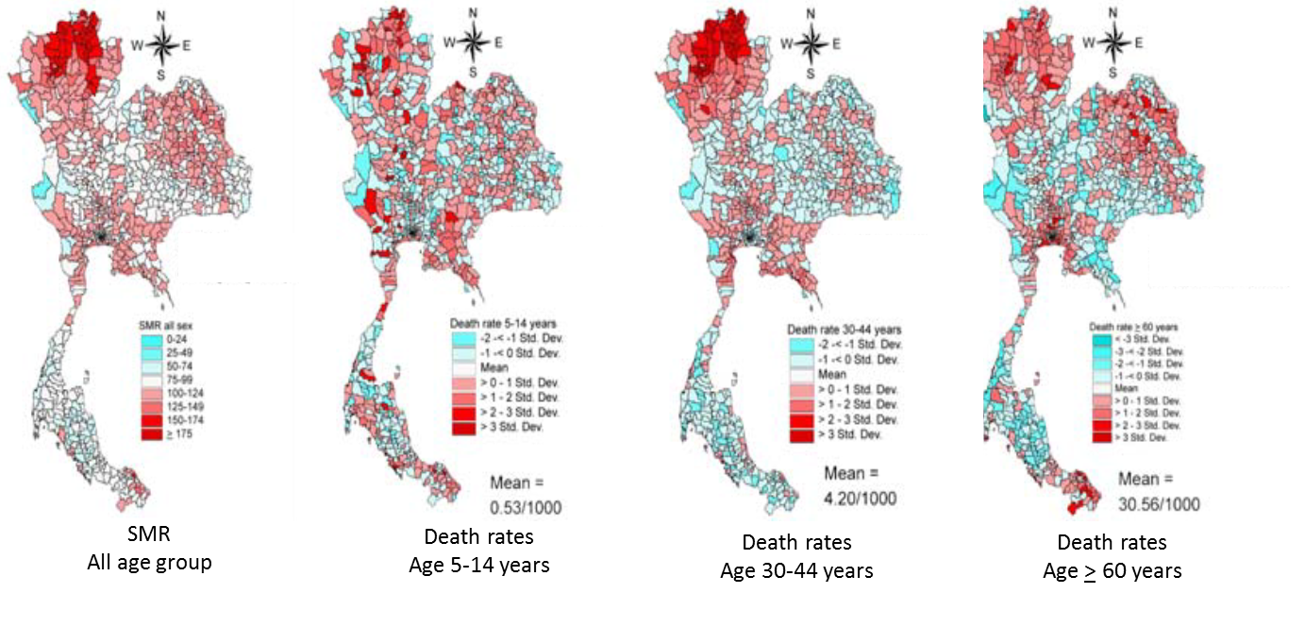
Inequalities of health status
Geographical variation (Faramnuayphol, 2008)
Notes:
Health status also varies by geography. Several studies on geographical mortality in Thailand have been conducted over the last decade and most studies found the north and northeast region tended to have higher mortality. Like this study, They also came into similar geographical variations of mortality results. They used national vital registration data in 2000 and found that the geographical distribution of overall mortality was concentrated in the middle part of the upper north on the first, as well as the mortality of the working age or aged 30 – 40 years at the third map

Slide 4
Mortality during 2001-2014

Slide 5
Geographical distributions of average annual SMR, 2001-2014

Slide 6
Geographical distributions of average annual age-specific mortality rate, 2001-2014

Slide 7
Trend in super-district death rate and CV by age group, 2001-2014

Slide 8
Geographical distributions of average annual cause-specific SMR, 2001-2014

Slide 9
Trend in super-district cause specific mortality rates, six selected conditions, by region, 2001-2014

